Slide 2
Counting
11.1 Generating Permutations and Combinations
11.2-11.3 Binominal coefficient, Pigeon hole Principle

Slide 4
11.1 Generating permutations and combinations
Lexicographic order is a way of ordering n-tuples in which two n-tuples are compared according to the first entry where they differ.
Words in a dictionary are ordered in lexicographic order.
For example, the word "comment" appears before the word "compare" because the first place where the two words differ is the 4 character and "m" appears before "p" in the alphabet.
NextPerm(p₁, p₂, …, p_{n}) Let k be the largest index such that p_{k} < p_{k+1} If no such k exists then (p₁, p₂, …, p_{n}) is the last permutation Let p_{j} be the smallest element such that j > k and p_{j} > p_{k} Swap p_{j} and p_{k} Reverse the order of p_{k+1}, …, p_{n} Return( p₁, p₂, …, p_{n} )
GenLexPermutations(n) Initialize P = (1, 2, …, n - 1, n) Output P While P ≠ (n, n - 1, …, 2, 1), P = NextPerm(P) Output P

Slide 5
Breakdown of algorithm
GenLexPermutations(n) Initialize P = (1, 2, …, n - 1, n) Output P While P ≠ (n, n - 1, …, 2, 1), P = NextPerm(P) Output P
GenLexPermutations(n)
P= (1,2,…n-1,n)
While P!=(n, n-1, … 2, 1)
P = nextPerm(p1, p2,…pn)
NextPerm
NextPerm(p₁, p₂, …, p_{n}) Let k be the largest index such that p_{k} < p_{k+1} If no such k exists then (p₁, p₂, …, p_{n}) is the last permutation Let p_{j} be the smallest element such that j > k and p_{j} > p_{k} Swap p_{j} and p_{k} Reverse the order of p_{k+1}, …, p_{n} Return( p₁, p₂, …, p_{n} )

Slide 6
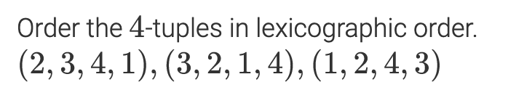
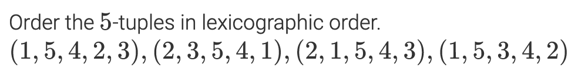
Order Permutation
A
B
C
A
B
C
C

Slide 7
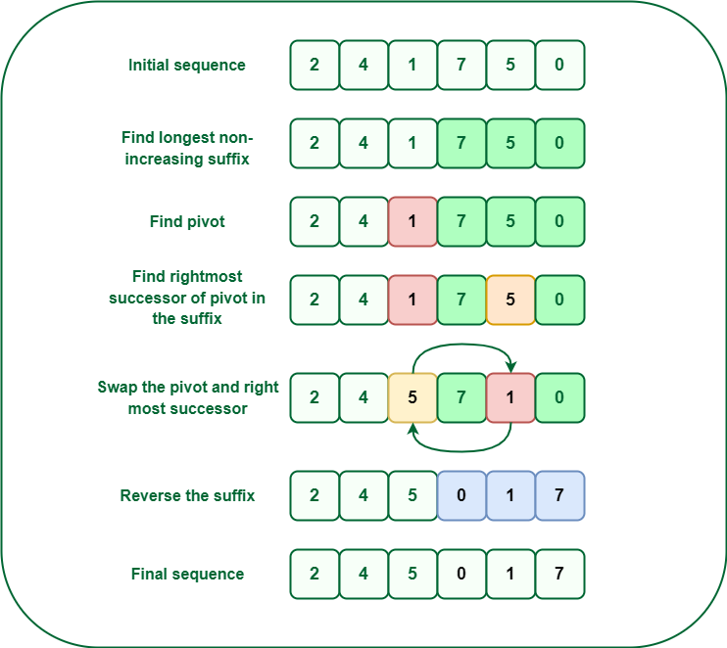
What it the next permutation of set {1,2,3,4,5} in lexicographic order after
(2,5,3,1,4)?
(2,5,3,4,1)
(2,5,4,1,3)…
(2,5,4,3,1)
(3,1,2,4,5)
NextPerm(p₁, p₂, …, p_{n}) Let k be the largest index such that p_{k} < p_{k+1} If no such k exists then (p₁, p₂, …, p_{n}) is the last permutation Let p_{j} be the smallest element such that j > k and p_{j} > p_{k} Swap p_{j} and p_{k} Reverse the order of p_{k+1}, …, p_{n} Return( p₁, p₂, …, p_{n} )
Search from right to left until the current number is less than the one before
Find the smallest number to the right of that is greater than 1
Swap
Reorder in increasing order

Slide 8
Next Permutation
Enter the next permuation of set {1,2,3,4,5,6,7} in lexicographic order.
(1,7,4,6,5,3,2)
(1,7,4,6,5,3,2)
(1,7,5,2,3,4,6)
(1,7,5,2,3,6,4)
(1,7,5,2,4,3,6)
(1,7,5,2,4,6,3)
(1,7,5,2,6,4,3)
Search from right to left until the current number is less than the one before
Find the smallest number to the right of that is greater than 1
Swap
Reorder in increasing order
NextPerm(p₁, p₂, …, p_{n}) Let k be the largest index such that p_{k} < p_{k+1} If no such k exists then (p₁, p₂, …, p_{n}) is the last permutation Let p_{j} be the smallest element such that j > k and p_{j} > p_{k} Swap p_{j} and p_{k} Reverse the order of p_{k+1}, …, p_{n} Return( p₁, p₂, …, p_{n} )

Slide 9
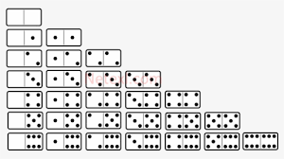
Next Largest Subset
GenLexSubsets(r, n) Initialize S = {1, 2, …, r-1, r} Output S While S ≠ {n-r+1, …, n-1, n}, S = NextSubset(n, S) Output S
Next Largest Subset is different than the nextPerm.
Sorted subsets are compared
The 3-subsets of the set {1, 2, 3, 4, 5} {
{1, 2, 3} < {1, 2, 4} < {1, 2, 5} < {1, 3, 4} < {1, 3, 5} < {1, 4, 5} < {2, 3, 4} < {2, 3, 5} < {2, 4, 5} < {3, 4, 5}
Given r-subset (5-subset) of {1,2,3,4,5,6,7,8, 9}
What is the next largest subset?
{1,2,3,4,5} -> {1,2,3,4,6}
{1,2,3,4,9} -> {1,2,3,5,6}
…
{1,2,4,8,9} -> {1,2,5,3,4} next Perm -> order {1,2,3,4,5}
{1,2,4,8,9} -> {1,2,5,8,9} next subset
…
{4,5,7,8,9} -> {4,6,7,8,9}
NextSubset(n, {s₁, s₂, …, s_{r}}) Let k be the largest index such that s_{k} < n - r + k If no such k exists then {s₁, s₂, …, s_{r}} is the last r-subset of {1, 2, …, n}. s_{k} := s_{k} + 1 For j = k+1 to r s_{j} := s_{j-1}+1 Return( {s₁, s₂, …, s_{r}} )

Slide 10
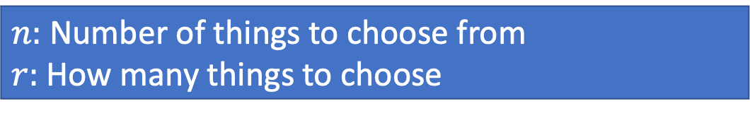
Break down of Algorithm
$n:$ Number of things to choose from
$r:$ How many things to choose
GenLexSubsets(r, n) Initialize S = {1, 2, …, r-1, r} Output S While S ≠ {n-r+1, …, n-1, n}, S = NextSubset(n, S) Output S
S={1,2,…r-1,r}
While S != {n-r+1, …n-1, n} where k=1…n
S= NextSubSet(n, S, k)
NextSubSet(n, S={s1, s2,… sr-1, sr}, k)
k is index, k=0…n; sk < n-r+k
sk := sk+1
For j = k+1 to r
sj = s(j-1) + 1
Return ({s1, s2, … sr}
NextSubset(n, {s₁, s₂, …, s_{r}}) Let k be the largest index such that s_{k} < n - r + k If no such k exists then {s₁, s₂, …, s_{r}} is the last r-subset of {1, 2, …, n}. s_{k} := s_{k} + 1 For j = k+1 to r s_{j} := s_{j-1}+1 Return( {s₁, s₂, …, s_{r}} )

Slide 11
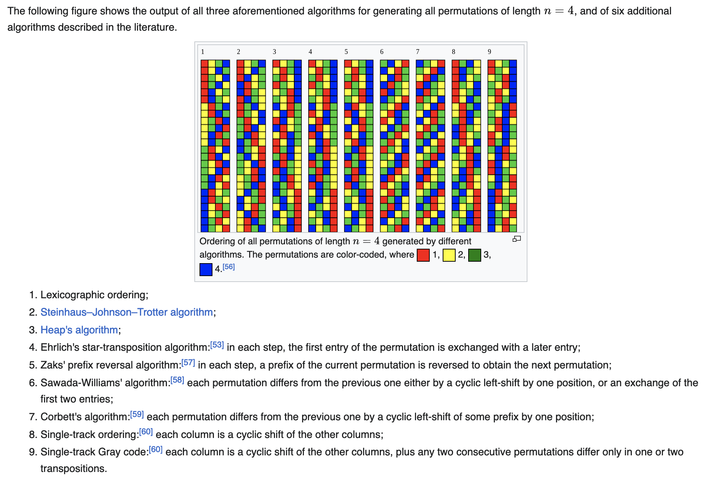

Slide 12
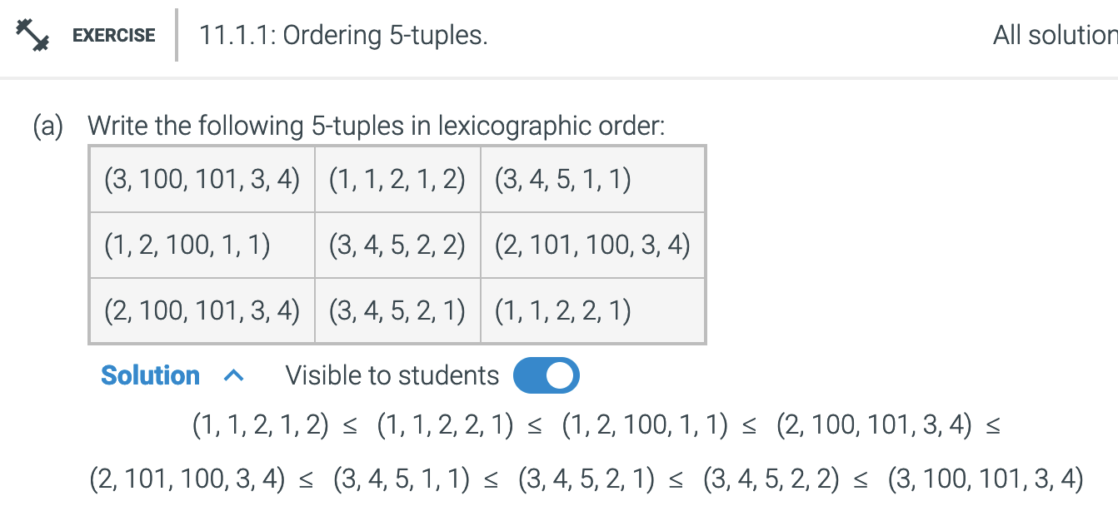

Slide 13
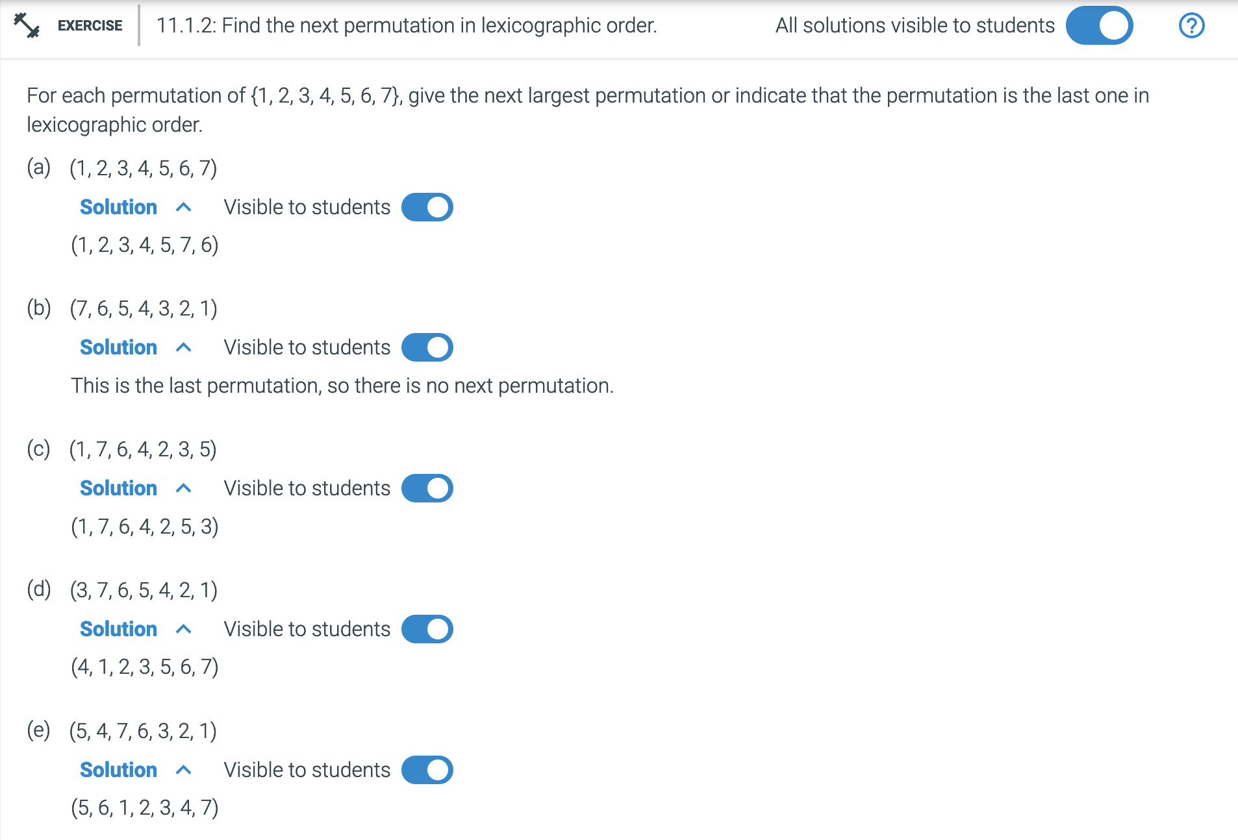
Search from right to left until the current number is less than the one before
Find the smallest number to the right of that is greater than 1
Swap
Reorder in increasing order

Slide 14
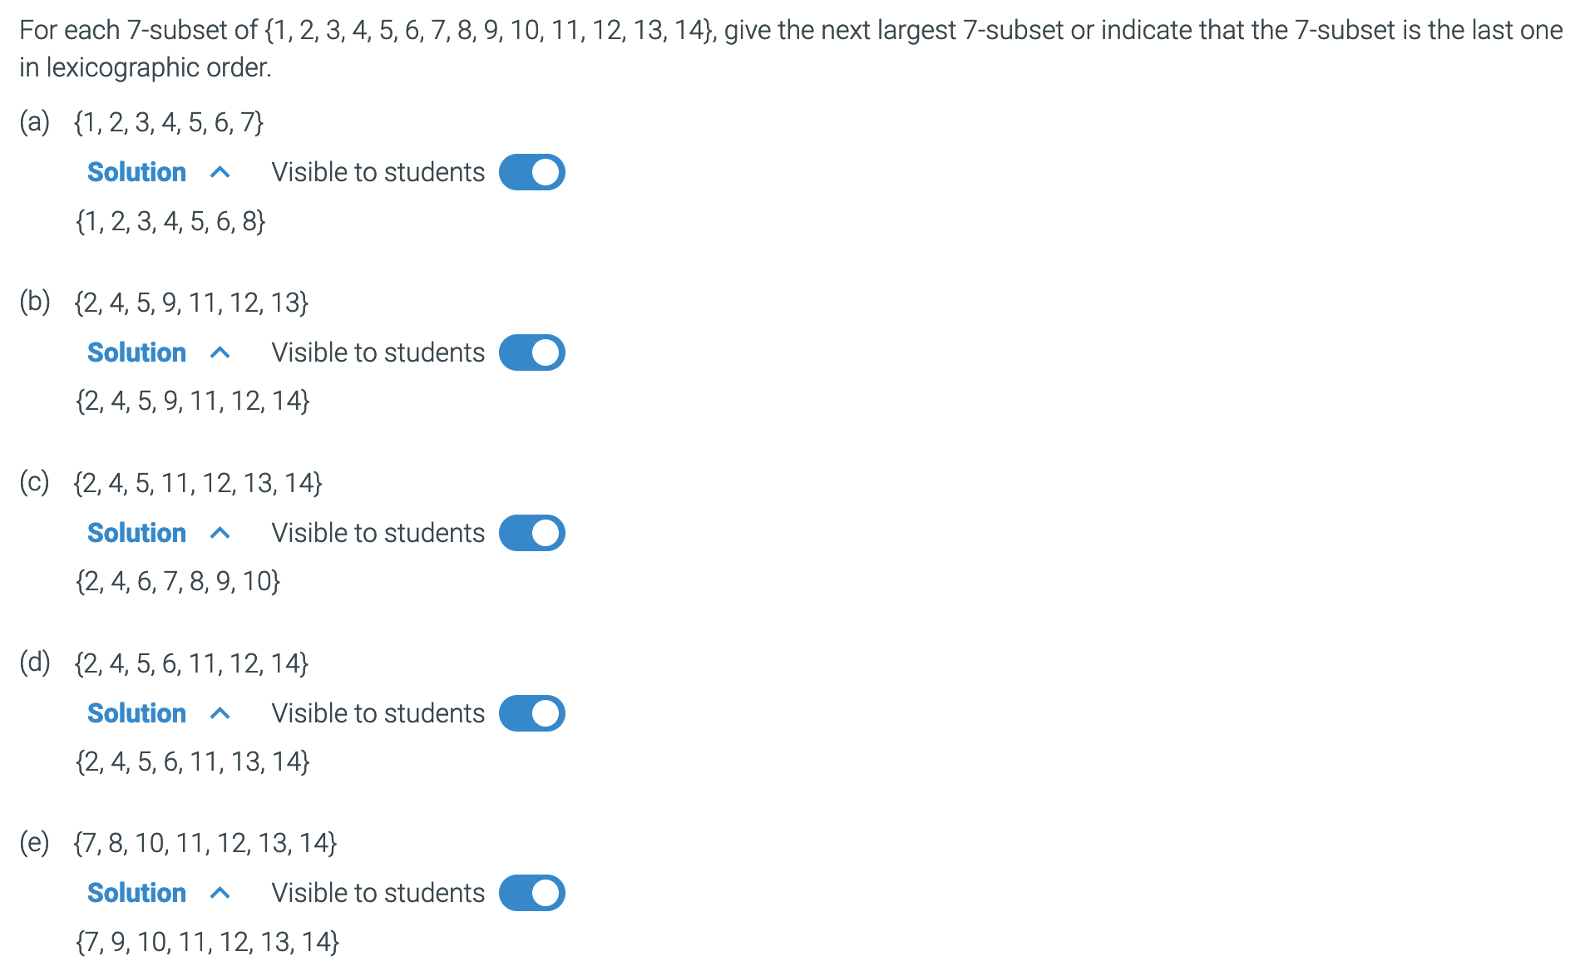
______
Is this the first one?
What does the last one look like?
That was easy, what does then next one look like?
Why did it restart at 7?
Easy again, what is the next sequence?
If it is 12, what numbers are left?
Remember: It is ordered
Where is 7,9, 1, 2, 3, 4, 5?
Would be {1,2,3,4,5,7,9}
What was the previous number? What is the next number?

Slide 15
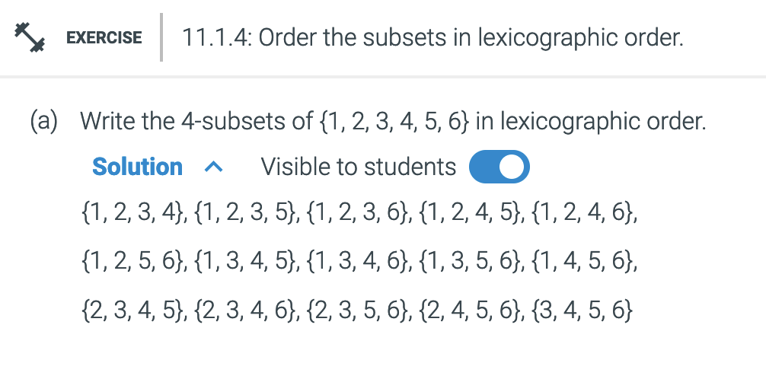

Slide 16
Application of Combinations in Algrabra

Slide 17
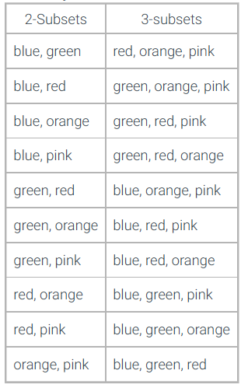
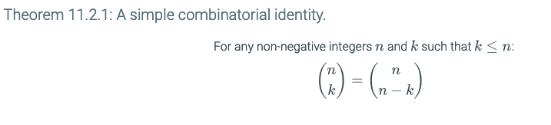
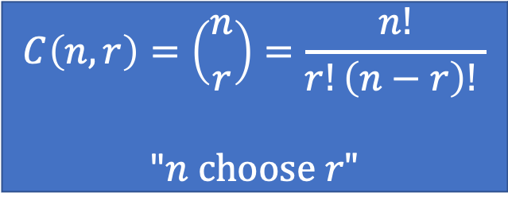
Order does not matter
$$C\left(n,r\right)=\left({n \atop r}\right)=\frac{n!}{r!\left(n−r\right)! }$$
"$n choose r"$
Set of color = {blue, green, red, orange, pink} N= 5
k=0…n
How many different combinations are there for
r=k == r=n-k
r=2 == r=3

Slide 18

Proof
Order does not matter
$$C\left(n,r\right)=\left({n \atop r}\right)=\frac{n!}{r!\left(n−r\right)! }$$
"$n choose r"$
$C\left(n,r\right)=\frac{n!}{r!(n−r!)}$
$C\left(n,n−r\right)=\frac{n!}{(n−r)![(n−(n−r)!]}$
$C\left(n,n−r\right)=\frac{n!}{(n−r)![(n+(−n)+ r)!]}$
$C\left(n,n−r\right)=\frac{n!}{\left(n−r\right)!r!}$
$C\left(n,n−r\right)=C(n,r)$

Slide 19
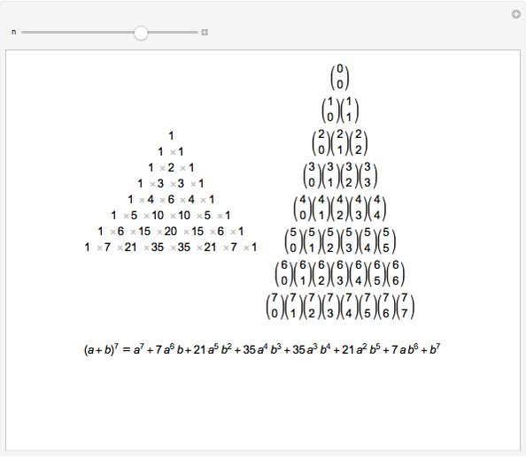
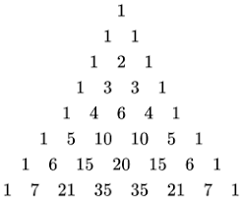
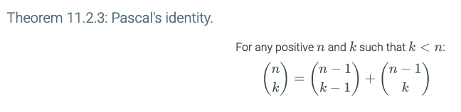
1
2
3
4
5
6
7
8
Recursively finding C(n,r) C(n,k)
r
2
3
N>
C(n,k) = C (n-1, k-1)+C(n-1, k)
If C(3, 4) then,? n<r invalid
If C(5, 3) then,
C(n-1, k-1) + C(n-1, k)
C(5-1, 3-1) + C(5-1, 3)
C(4 ,2) + C(. 4, 3)
4 + 6
10
C(5,3) = 5!/3!(2!)= 5*4*3!/3!*2!
=5*4/2! = 10
r >

Slide 20
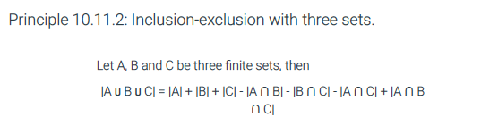
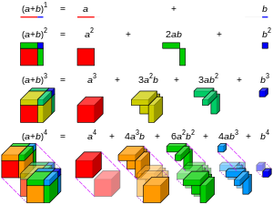
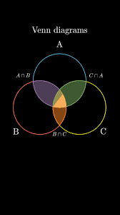
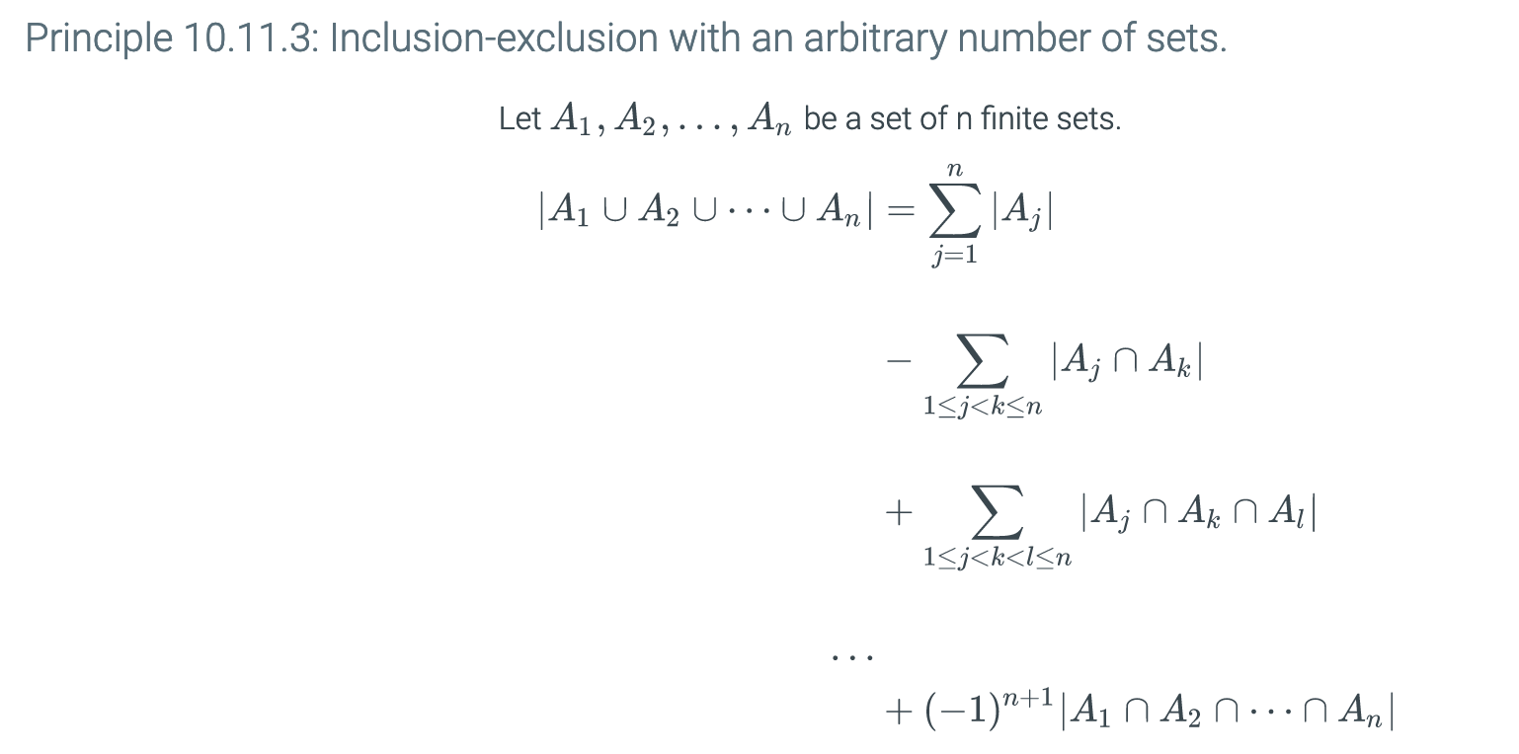

Slide 21
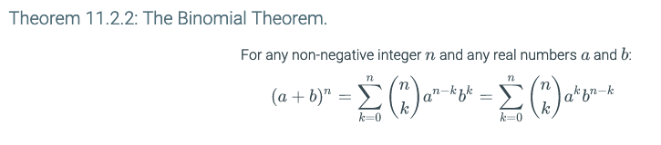

11.2 Binomial coefficients and combinatorial identities
Vandermonde’s Identity
Combining sets: Add elements (set m) to a set (n).
Let r< m|n, where r is the nuber of elements being picked
$C\left(m+n, r\right)= \sum_{k=0}^{r}{C\left(m, r−k\right)C(n,k)}$
Lexicographic order => all the sets

Slide 22

11.2 Binomial coefficients and combinatorial identities
Coefficient is the number of different combination sets for the powers of (x+y)^{n}
i.e. (x+y)³ = xxx + xxy + xyx + xyy + yaa + yxy + yyx + yyy
$i.e.\left(x+y\right)3=x3+3x2y+3xy2+y3$
1, 3, 3, 1 are the coefficient
What does n = 4, or 5, or 6
N = exponent, k = number of loops,
Coefficient is a Combination (n,k), where k<n; 0 to n

Slide 23
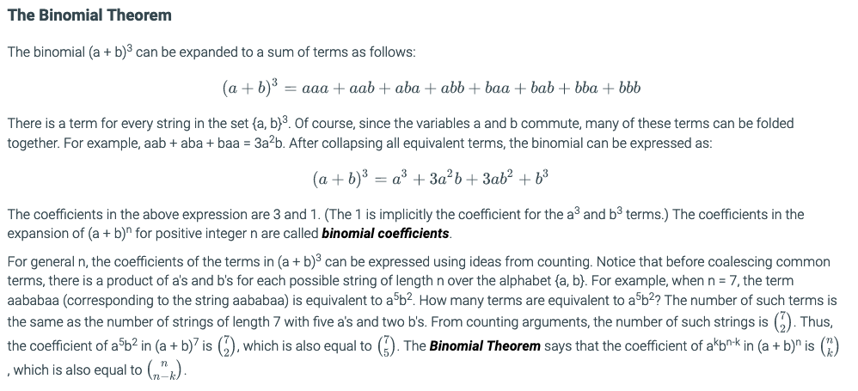
N>
k >

Slide 25
11.2 Binomial coefficients and combinatorial identities
Lexicographic order => all the sets
As k = 0…n

Slide 26
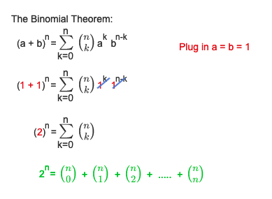
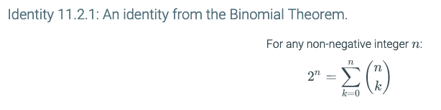

Slide 27
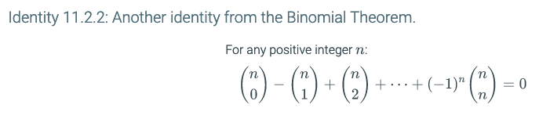
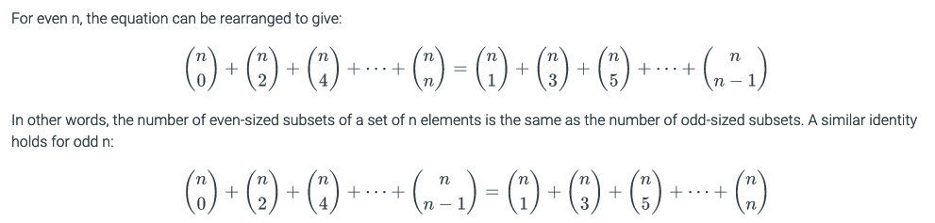

Slide 28
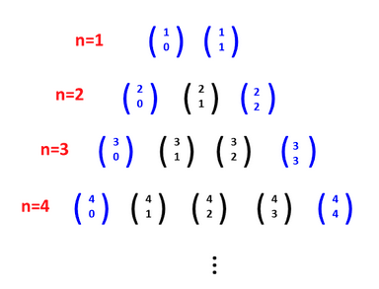
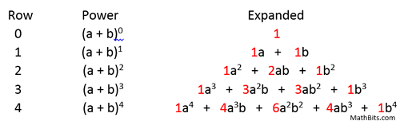
K= 1….n

Slide 29
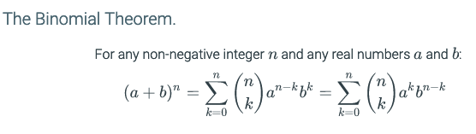
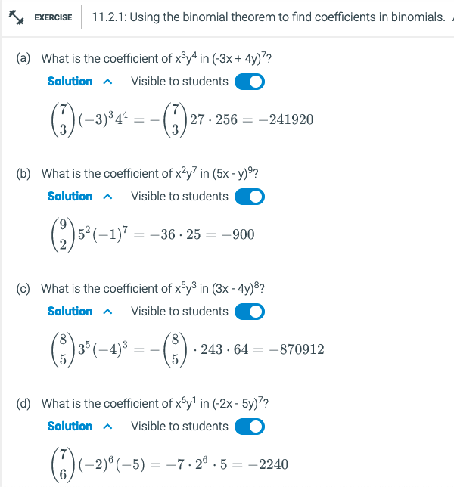

What is a, b, n, k
What is n-k
${\left(a+b\right)}^{n}=\sum_{k=0}^{n}{\left({n? \atop k?}\right){a?}^{k?}{b?}^{n?−k?}}$

Slide 30
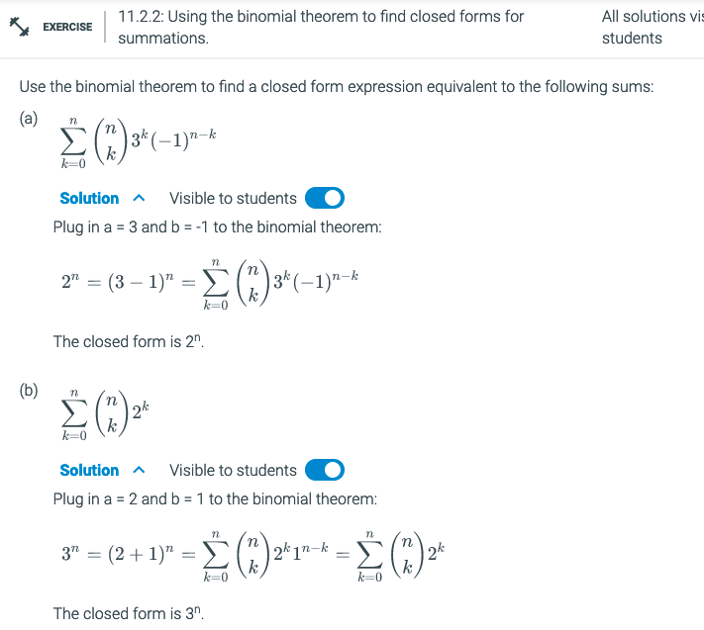

$${\left(a?+b?\right)}^{n}=\sum_{k=0}^{n}{\left({n \atop k}\right)a^{k}b^{n−k}}$$

Slide 31
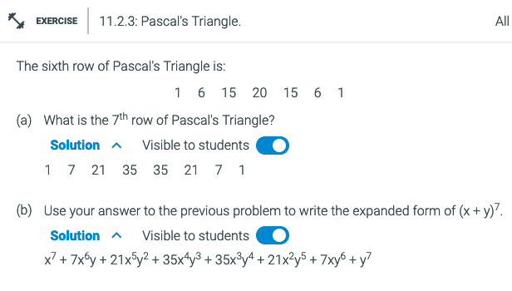

Slide 32
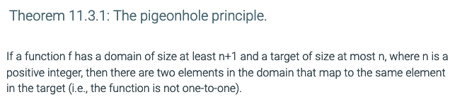
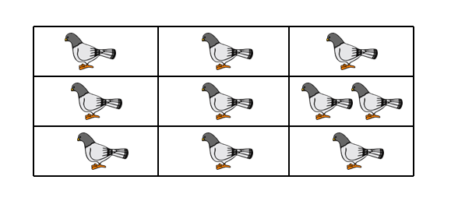
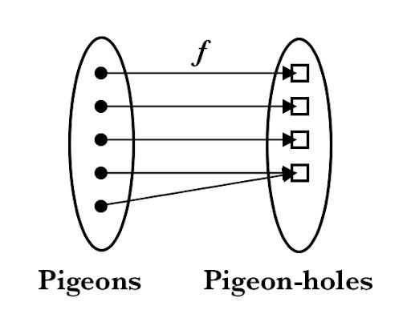
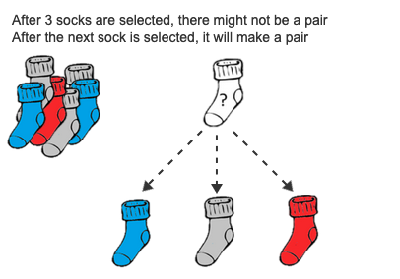
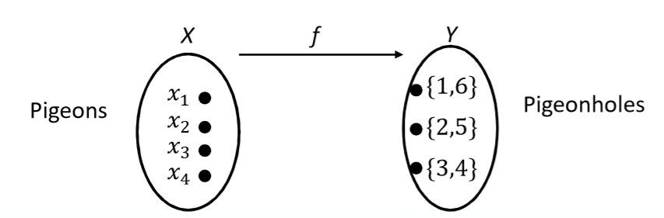
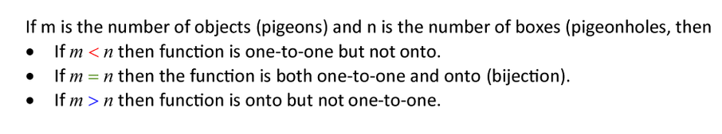
11.3 The pigeonhole principle
The pigeonhole principle says that
if n+1 pigeons are placed in n boxes,
then there must be at least one box with more than one pigeon.
Notes:
https://eportfolio.utm.my/user/chia-yin-jian/pigeonhole-principle

Slide 33


Slide 34
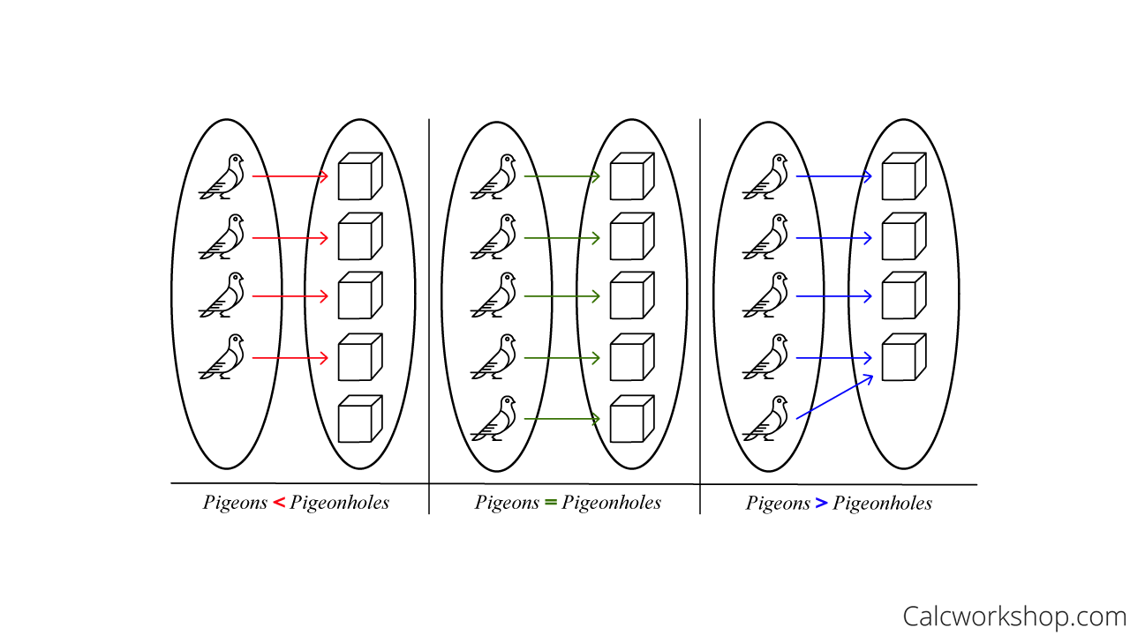
11.3 The pigeonhole principle
The pigeonhole principle says that
if n+1 pigeons are placed in n boxes,
then there must be at least one box with more than one pigeon.
Notes:
https://eportfolio.utm.my/user/chia-yin-jian/pigeonhole-principle

Slide 35
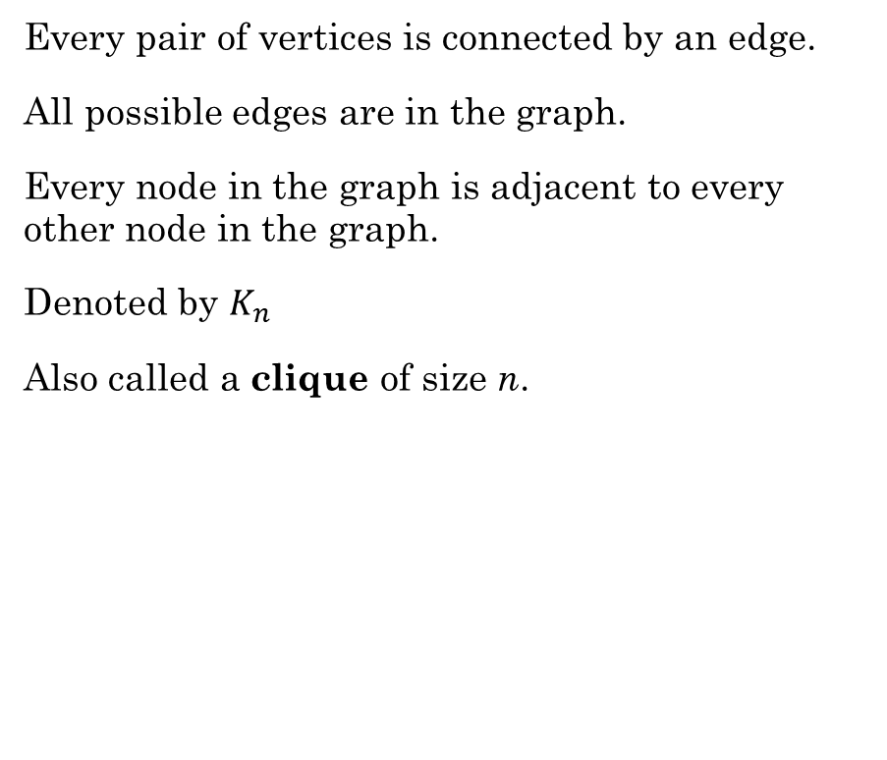
Complete Graph
Every pair of vertices is connected by an edge.
All possible edges are in the graph.
Every node in the graph is adjacent to every other node in the graph.
Denoted by $K_{n}$
Also called a clique of size n.

Slide 36
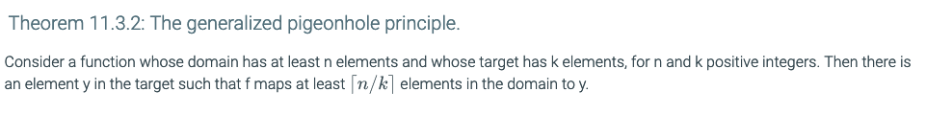
10.2 The bijection rule
Let S and T be two finite sets. If there is a bijection from S to T, then |S| = |T|.
K-to-1 Rule:
Suppose there is a k-to-1 correspondence from a finite set A to a finite set B. Then |B| = |A|/k.
Let n = 700 (pigeons) and
m = 35 pigeon holes
700/35 = ~20
Domain
N
A
Range
Co-Domain
K
B
|A|/k

Slide 37
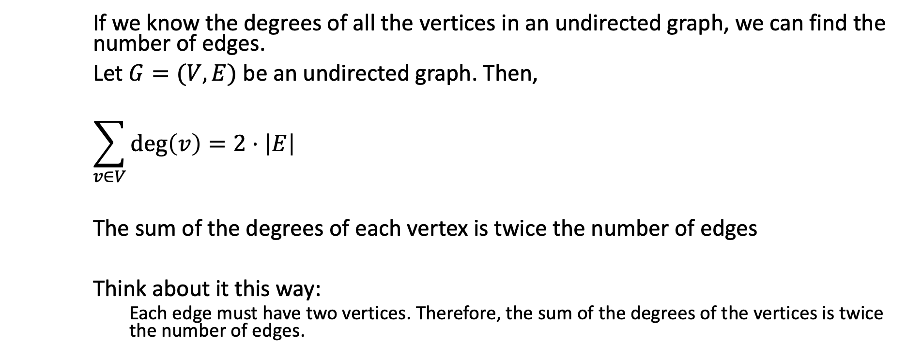
Remember Handshaking Theorem
If we know the degrees of all the vertices in an undirected graph, we can find the number of edges.
Let $G=(V, E)$ be an undirected graph. Then,
$$\sum_{v∈V}{\deg\left(v\right)=2⋅\left|E\right|}$$
The sum of the degrees of each vertex is twice the number of edges
Think about it this way:
Each edge must have two vertices. Therefore, the sum of the degrees of the vertices is twice the number of edges.

Slide 38
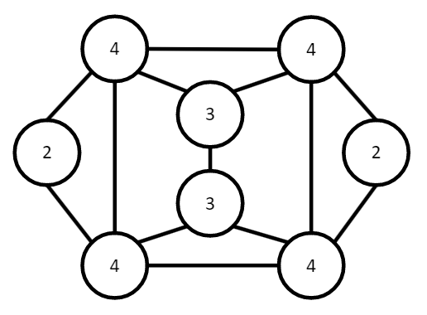

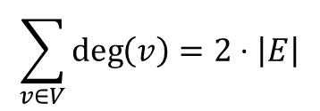
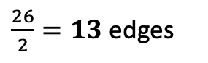
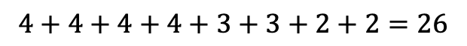
Remember Handshaking Theorem
$$\sum_{v∈V}{\deg\left(v\right)=2⋅\left|E\right|}$$
Example:
How many edges are in the graph with the following degree sequence?
$[4,4,4,4,3,3,2,2]$
$$4+4+4+4+3+3+2+2=26$$
$\frac{26}{2}=13$ edges
Count them. Is it true?

Slide 39

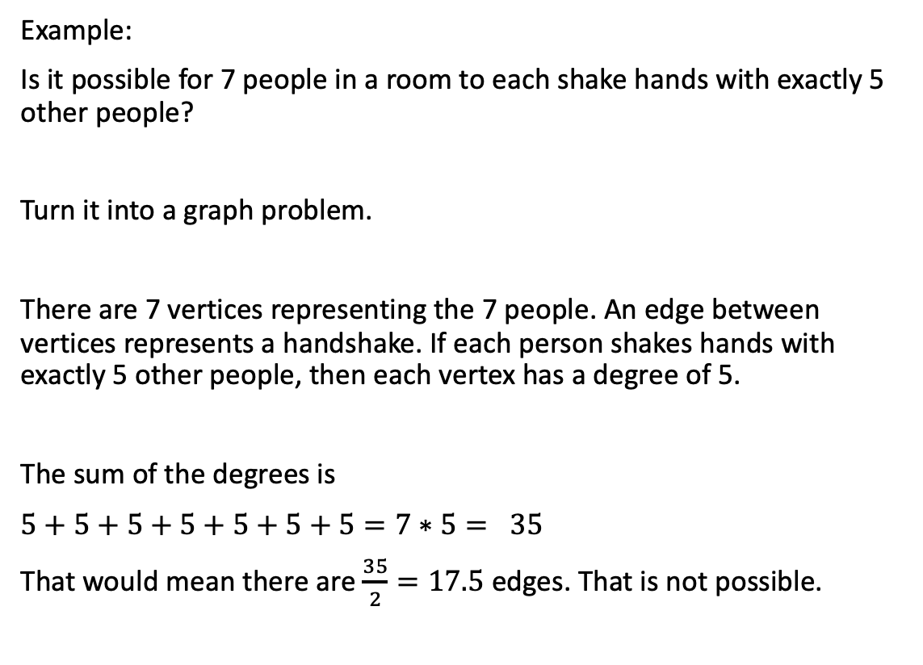
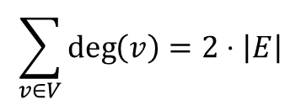
Handshaking Theorem
$$\sum_{v∈V}{\deg\left(v\right)=2⋅\left|E\right|}$$
Example:
Is it possible for 7 people in a room to each shake hands with exactly 5 other people?
Turn it into a graph problem.
There are 7 vertices representing the 7 people. An edge between vertices represents a handshake. If each person shakes hands with exactly 5 other people, then each vertex has a degree of 5.
The sum of the degrees is
$5+5+5+5+5+5+5=7∗5= 35$
That would mean there are $\frac{35}{2}=17.5$ edges. That is not possible.

Slide 40
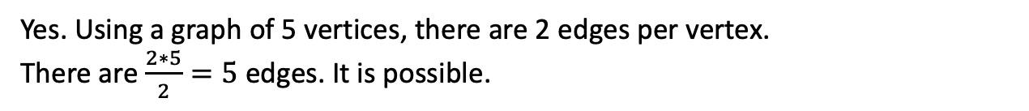
Handshaking Theorem
$$\sum_{v∈V}{\deg\left(v\right)=2⋅\left|E\right|}$$
Try it:
Among a group of 5 people, is it possible for everyone to be friends with exactly 2 of the people in the group?
What about with exactly 3 of the people in the group?
Yes. Using a graph of 5 vertices, there are 2 edges per vertex.
There are $\frac{2∗5}{2}=5$ edges. It is possible.
No. There are $\frac{5∗3}{2}=7.5$ edges. This is not possible.
Levin, Oscar. Discrete Mathematics, An Open Introduction, 3rd Edition. 2021

Slide 41
Handshake
Handshake
If n people can shake hands with one another (where n > 1), the pigeonhole principle shows that there is always a pair of people who will shake hands with the same number of people.
If the number of people handshake with one another, then according to the pigeonhole principle, there must exist two people who shake hands with the same people
Let n be the number of people p
N-1 be the number of handshakes h=k
P/h = 5/?

Slide 42
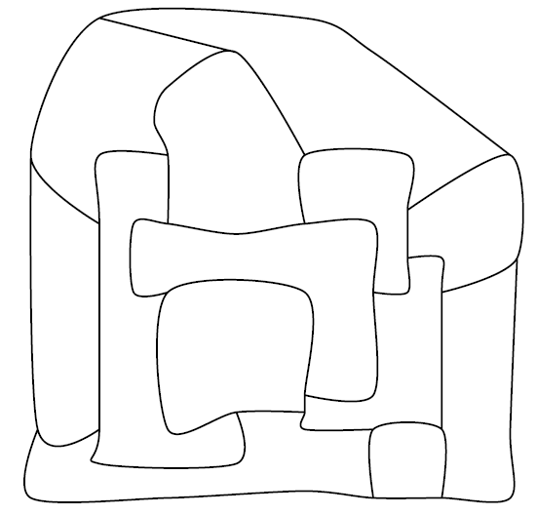


Coloring Graphs
The Four Color Theorem (proved in 1976), states that if a graph $G$ is planar, then its regions can be colored using 4 or fewer colors.
. When you consider the vertices of a graph as "pigeonholes" and the colors as "pigeons,“
the graph coloring problem can be viewed as an application of the Pigeonhole Principle.
If a graph requires fewer colors than the number of vertices (pigeonholes), then it's guaranteed that at least one color must be used more than once due to the Pigeonhole Principle.
Levin, Oscar. Discrete Mathematics, An Open Introduction, 3rd Edition. 2021

Slide 43
Chromatic Number
A
F
A
E
F
D
D
B
B
Chromatic Number is determined by Greedy Algorithm.
Find the node(n₁) with the most vertexes. Assign it one color.
Pick adjacent node to n₁, a color. Repeat until all adjacent noes to n₁ are colored.
E
C
C
A
A
F
F
D
D
B
B
E
C
E
C

Slide 44

"In an art gallery, what is the minimum number of guards who together can observe the whole gallery?"
In the geometric version of the problem, the layout of the art gallery is represented by a simple polygon and each guard is represented by a point in the polygon.
A set S of points is said to guard a polygon if, for every point p in the polygon, there is some q ∈ S in S such that the line segment between p and q does not leave the polygon.
If n objects are placed into k boxes, then there is a box containing at most n/k objects.
B = ceiling (N/K)
N = ((B-1)*K) + 1

Slide 45
A group of students is selected from a class.
Every student in the class is either in the 3 grade or the 4 grade, and no student is in both the 3rd and the 4th grades.
How many students must be selected in order to guarantee that at
least five 3 graders or b=5
at least five 4 graders are selected? K=2 - choices
K(b-1)+1 = 2(5-1) + 1 = 9

Slide 46



Slide 47

B = ceiling (N/K)
N = ((B-1)*K) + 1

Slide 48

(b) How many people must be selected to make sure that there are at least 20 who are born
in the same month?
k(b - 1) + 1= 12(20 - 1) + 1 = 229
B = ceiling (N/K)
N = ((B-1)*K) + 1

